Slide 1

The Atomic Human
Understanding Ourselves in the Age of AI
Neil D. Lawrence

Slide 2
Notes:
Bogeyman, Fred Garage. Henry Ford, More Intelligent Human

Slide 3


Slide 4
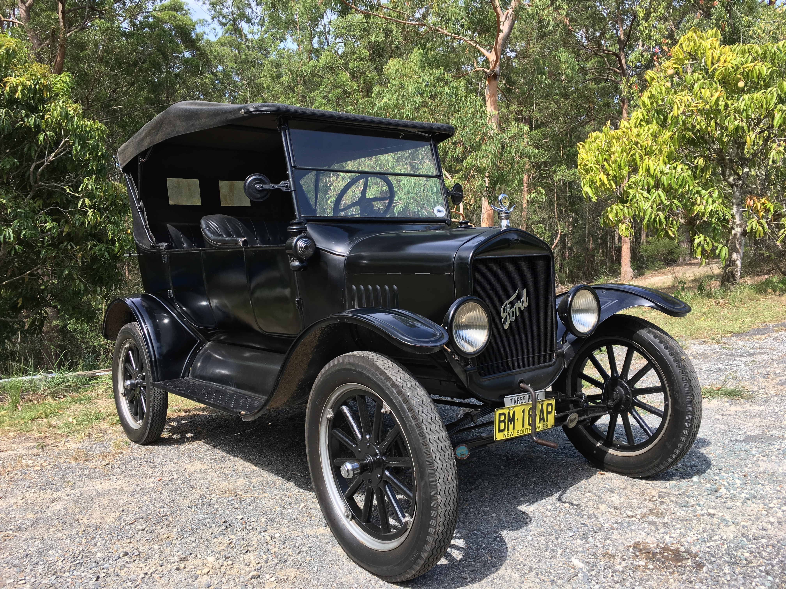

Slide 5


Slide 6
E S A R I N T U L
O M D P C F B V
H G J Q Z Y X K W

Slide 7
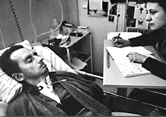
bits/minute
6
2000
billions
a billion
billion
a billion
billion
calculations/s
trillions
5 trillion
years
15 billion
years
20
minutes
embodiment

Slide 8
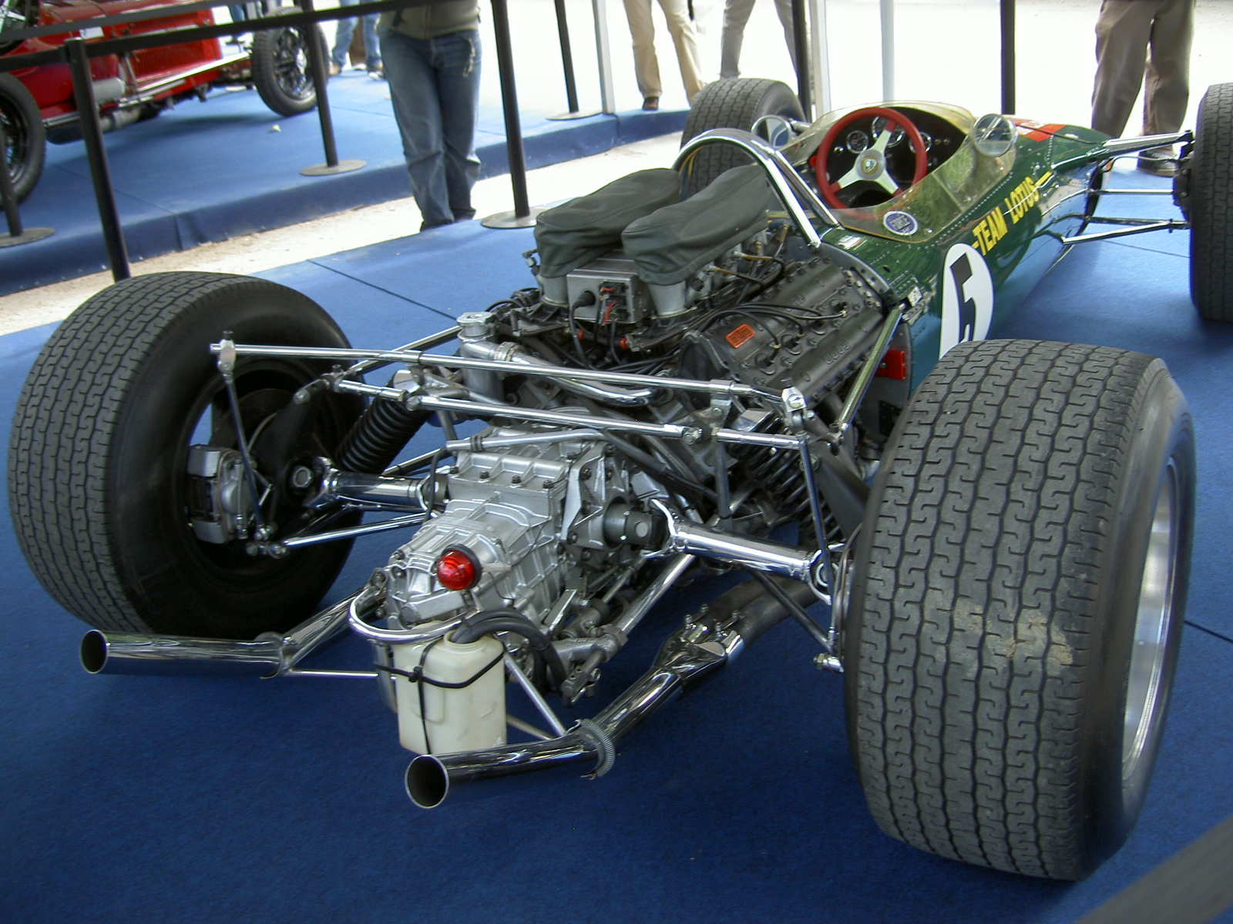
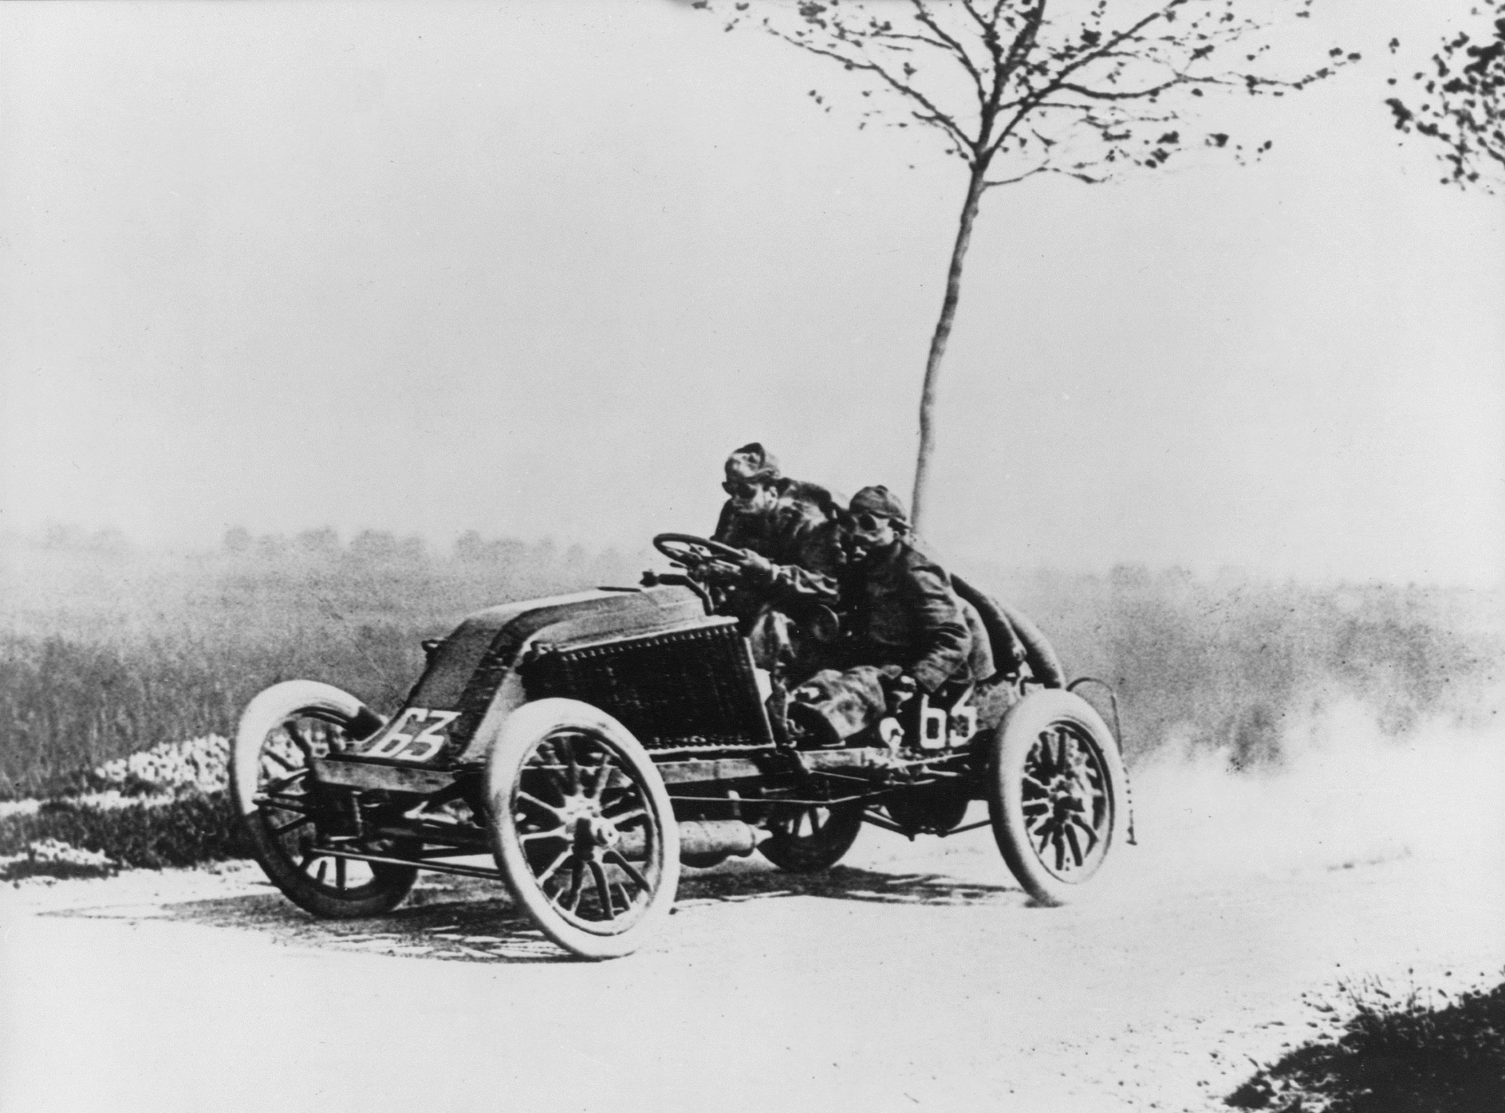
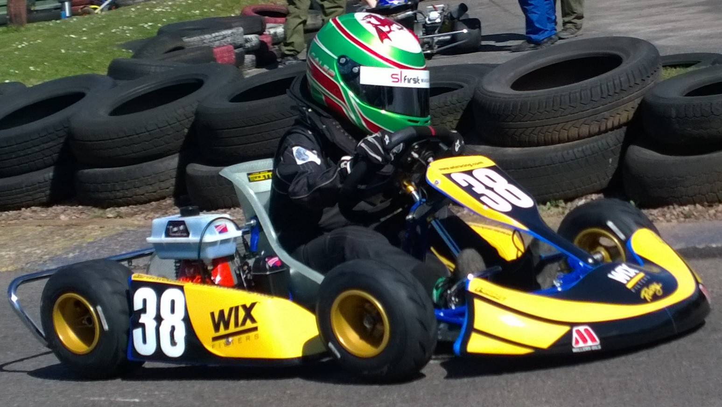

Slide 9
?
!#@%&?
#
!
&
!
£*?$&!
&
?
#

Slide 10
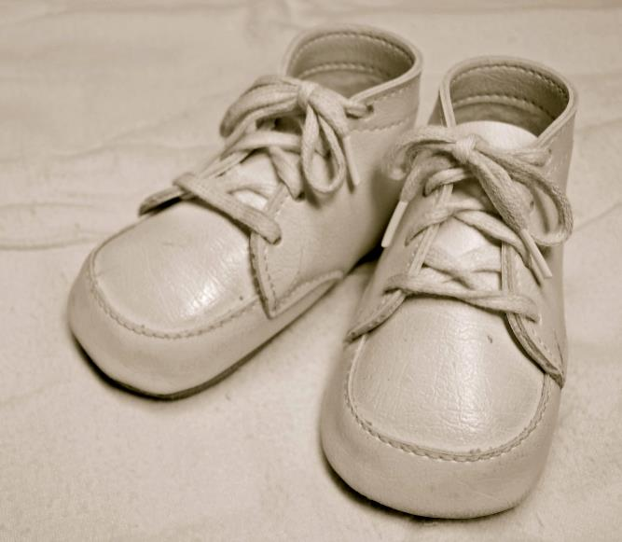
For Sale, Baby Shoes, Never Worn

Slide 11
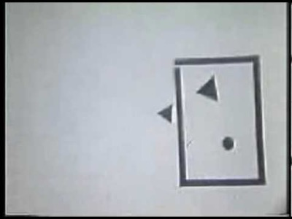

Slide 12
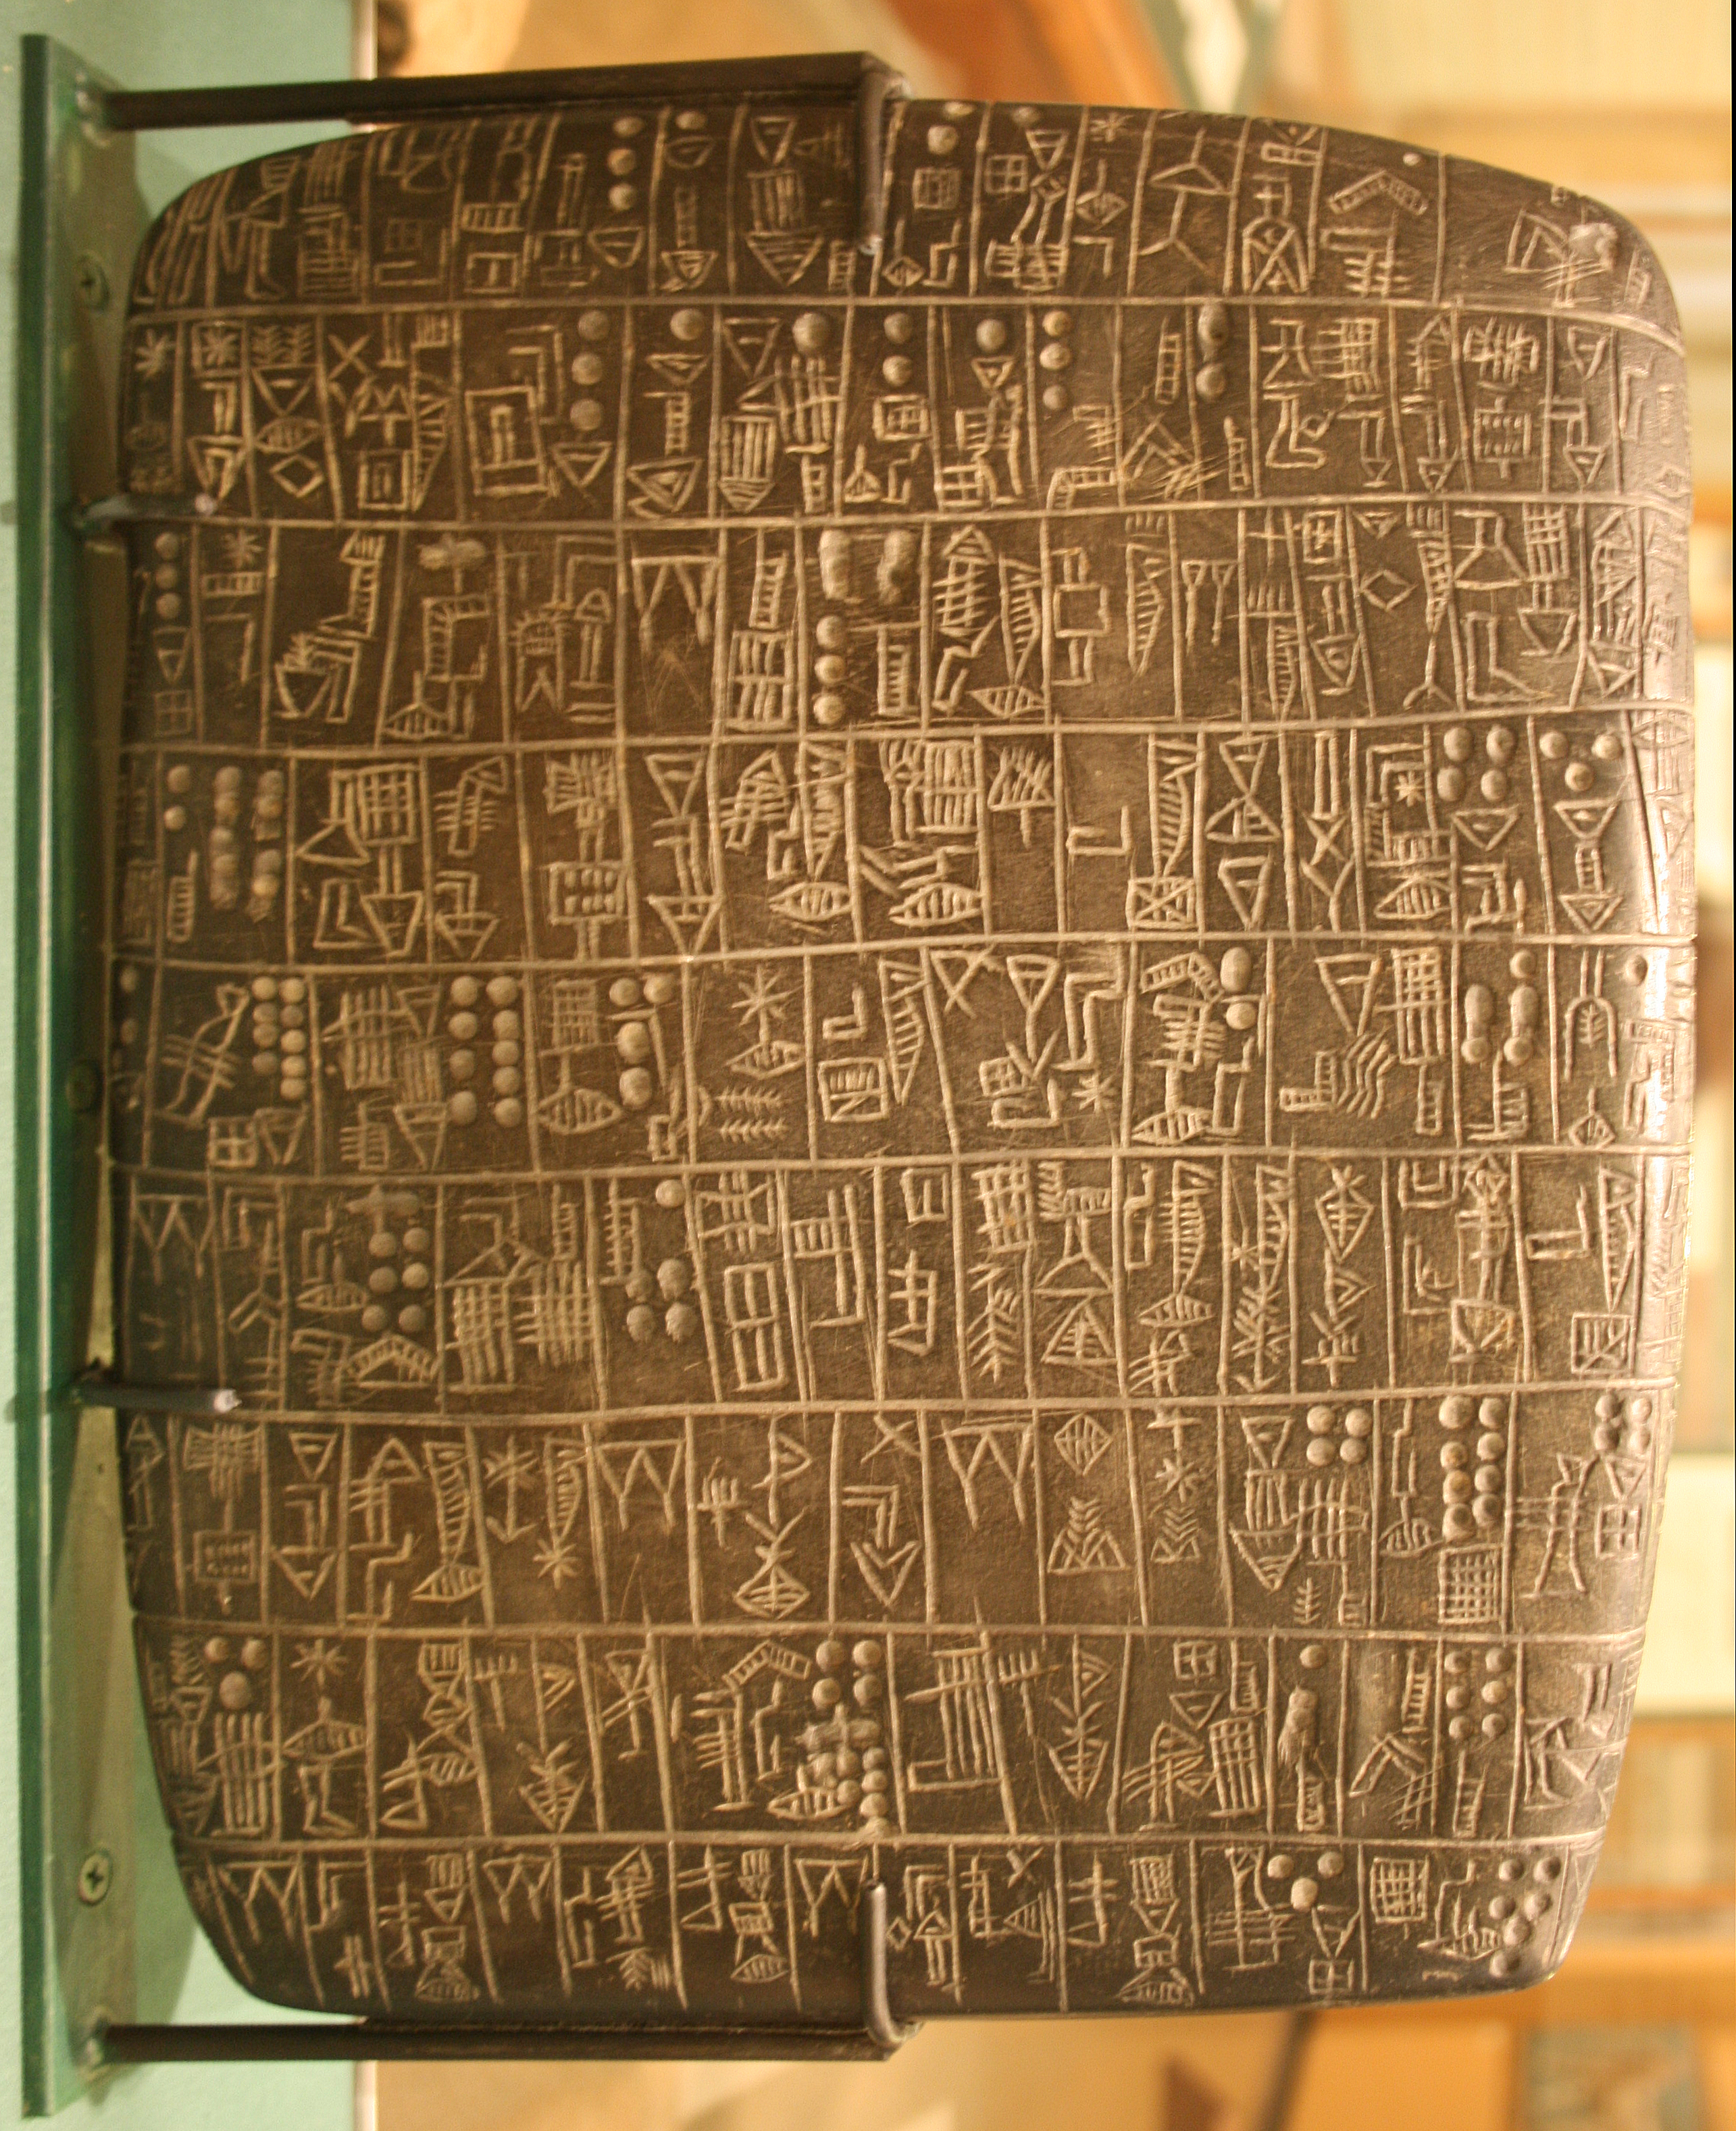

Slide 13


Slide 14
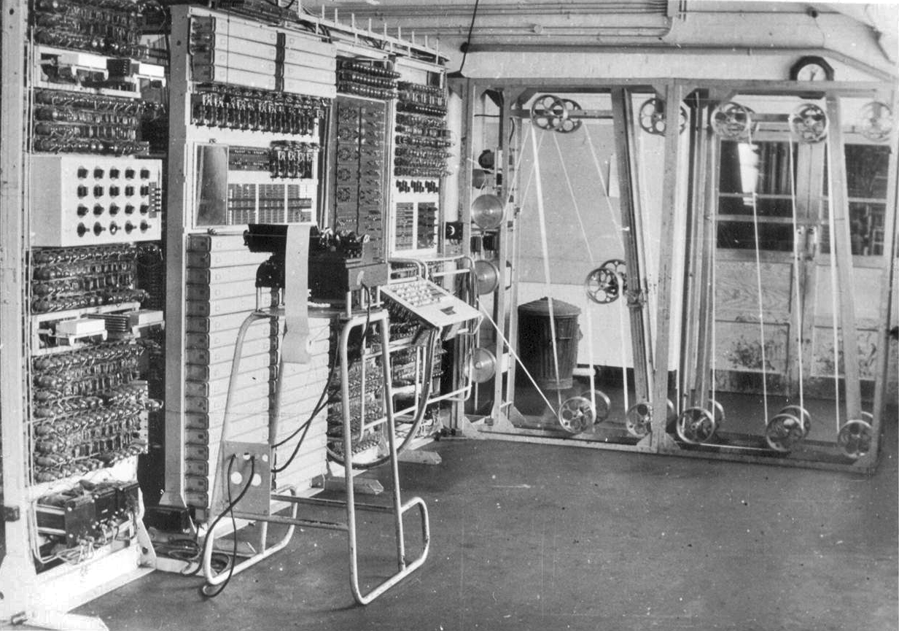

Slide 15
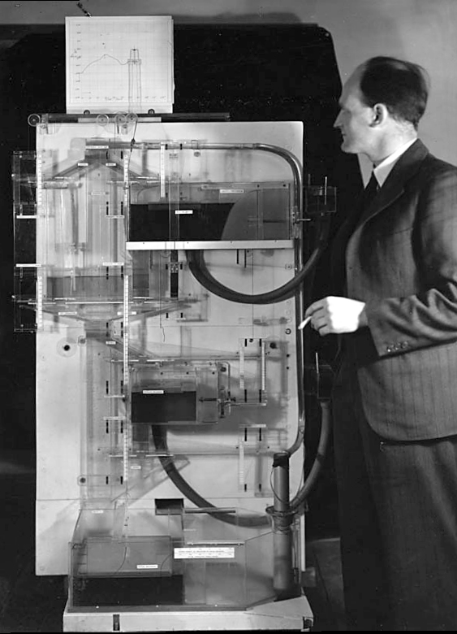
Notes:
Bill Phillips standing next to the MONIAC

Slide 17
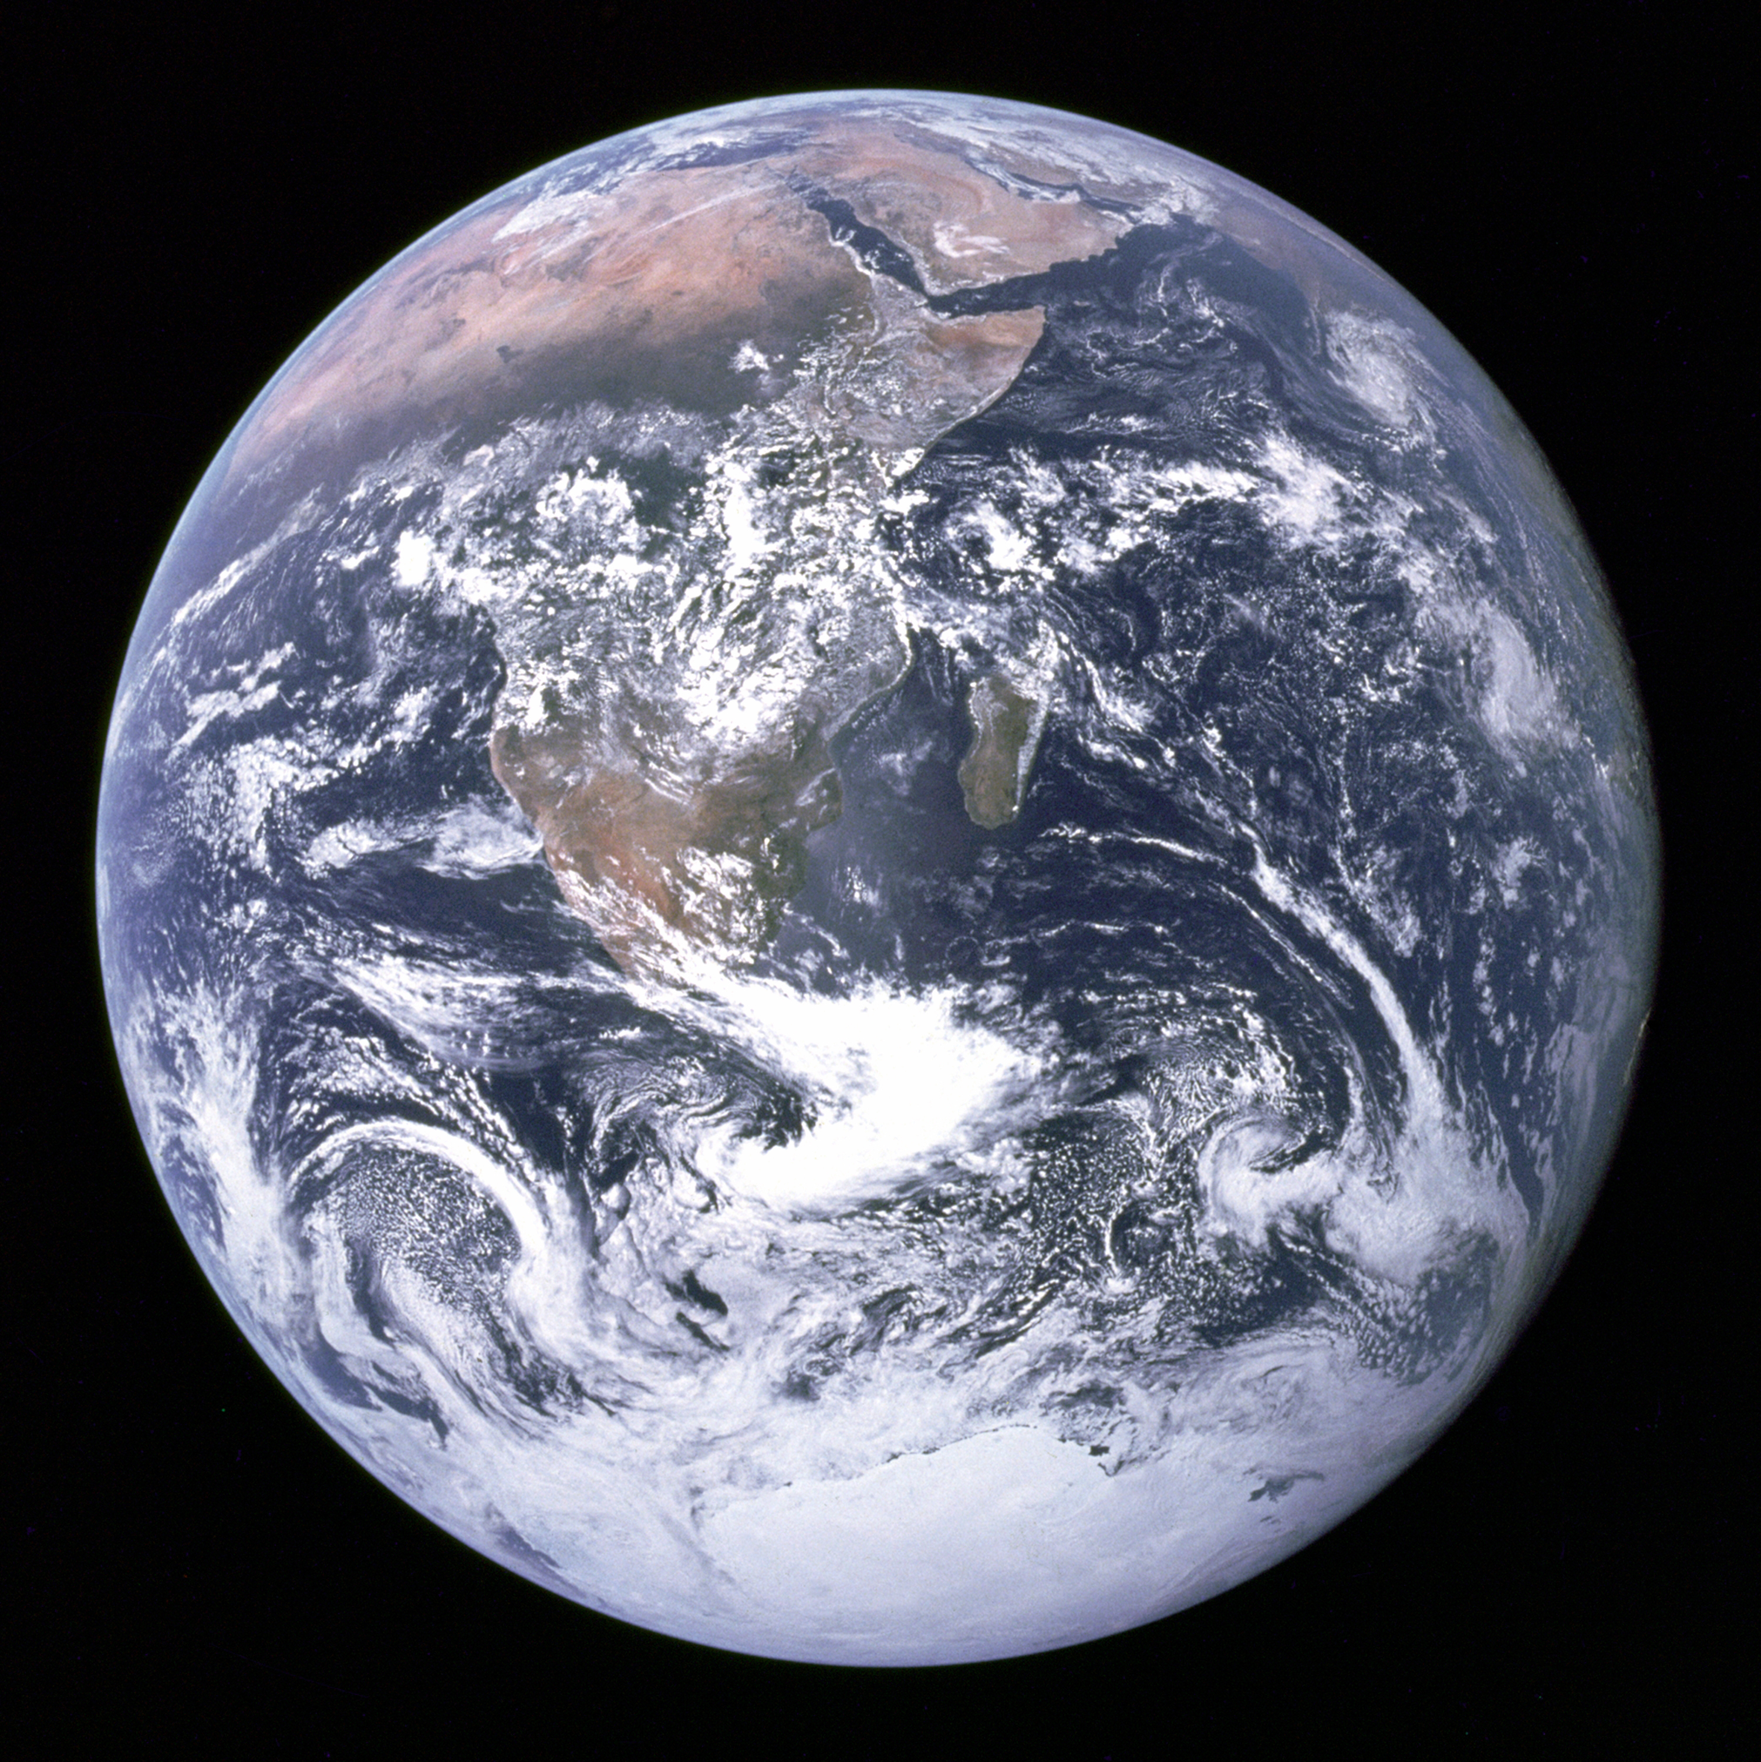

Slide 18
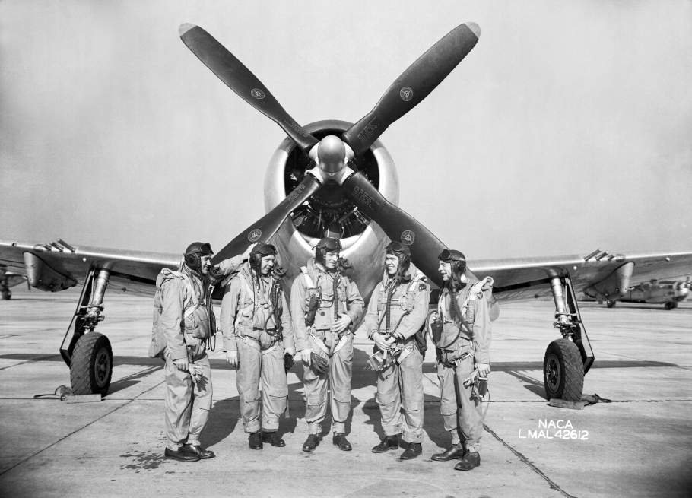
Notes:
NACA test pilots, bob gilruth

Slide 19
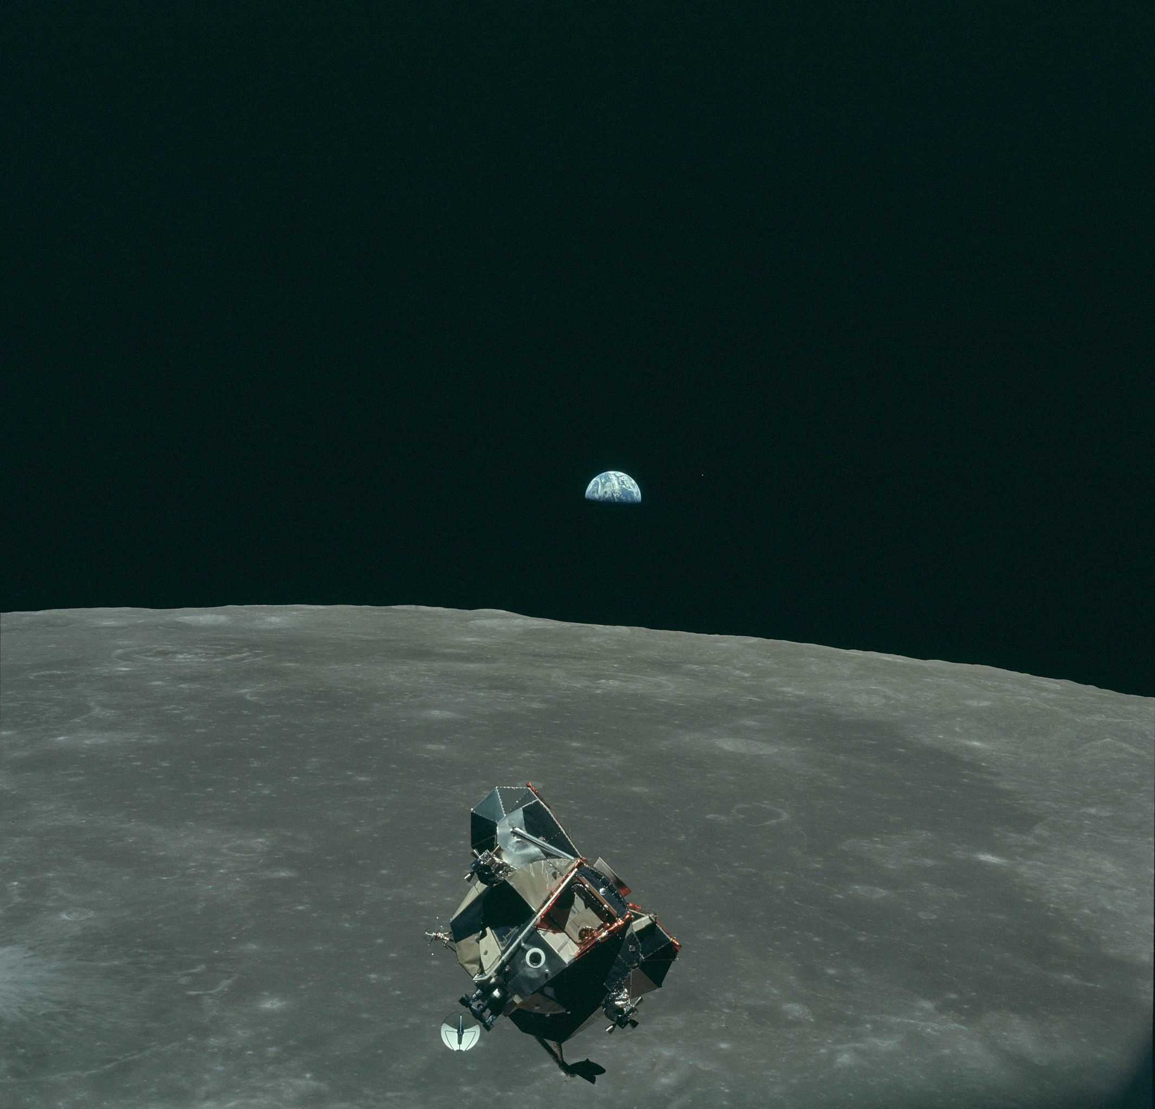

Slide 21

Available from 6th June 2024
Thanks!

